Slide 1
Benchmarks for
Text Correction Services
NLPCS 2014 Venice, ITALY
Jared Bernstein
Stanford University, California, USA
Università Ca’ Foscari, Venice, Italy
Alexei Ivanov
Fondazione Bruno Kessler, Trento, Italy
Elizabeth Rosenfeld
Tasso Partners LLC, Palo Alto, California, USA
Notes:
1

Slide 2
A Request to Compare
“We’re thinking of buying a grammar checker”
An outside vendor claims high performance and unique technical approaches.
The in-house group says theirs works better and they are on the cusp of world-beating improvements.
Top management wants to buy.
Line management supports the in-house group.

Slide 3
Application Context
Publisher sells an iterative writing tutor
  Designed for secondary school students (age 12-18)
  Basic task is drafting and re-writing essays
  Automatic content analysis
  Automatic detection and identification of errors in form
Publisher has faith in the content analysis
Seeks improvement in specific-error detection
  Teachers complain; competitors seem more accurate

Slide 4
Comparison in Finite Time
Compare in-house QG to vendor’s FB
  Texts from grades 7-9.
  24 random essays from random points in the correction cycle.
Error Focus: Grammar Checker function
  Within-Sentence grammar, usage, conventions, spelling …
  Not problems in meaning, style, coherence, flow, etc.
1. Which engine (QG ~ FB) is more accurate?
2. How large and/or significant is the difference?
Notes:
4

Slide 5
Prior Work (Essay Scoring)
Most work has been on scoring
Project Essay Grade (PEG) Page 1966
LSA at U.Colorado & Pearson Foltz, Landauer et al 1998
ETS Burstein et al 1998
Early evaluation/feedback for editing & proof-reading
  The Writer’s Workbench MacDonald 1982
Scoring: correlation with human expert ~ 0.87-0.95
Feedback: proprietary expert systems; performance unknown
Notes:
5

Slide 6
Technical Problem
Essay scoring is simpler than essay feedback;
Scoring (form & content, A-F or 0-10): 4-5 bits
  But teachers like to provide constructive feedback;
Feedback (location & error-type labeling)
  300 word essay may require 80-90 bits
    ~ 60 phrases
    75% chance to be correct
    6 equi-probable incorrect labels.

Slide 7
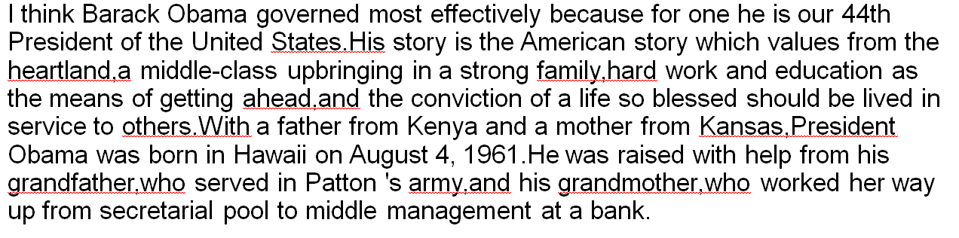
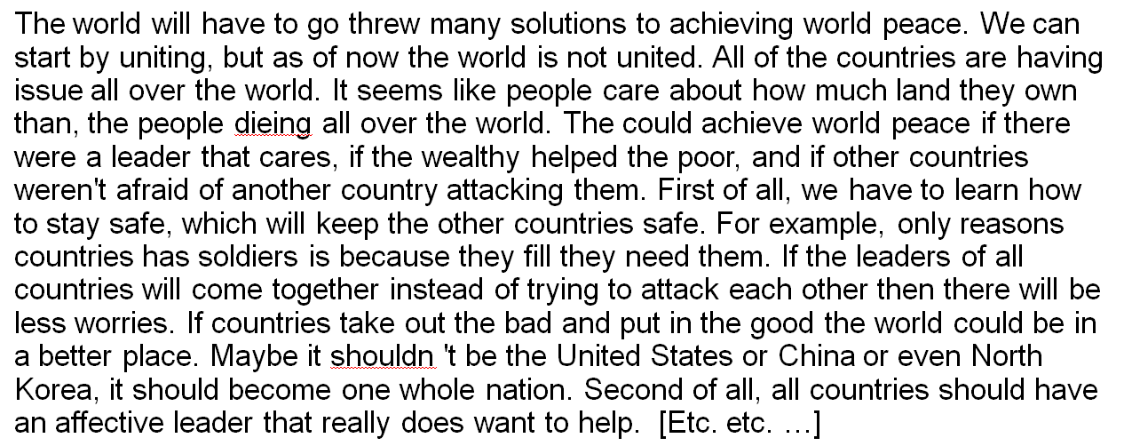
Sample Material (w/ Microsoft error marking)
Notes:
7
I think Barack Obama governed most effectively because for one he is our 44th President of the United States.His story is the American story which values from the heartland,a middle-class upbringing in a strong family,hard work and education as the means of getting ahead,and the conviction of a life so blessed should be lived in service to others.With a father from Kenya and a mother from Kansas,President Obama was born in Hawaii on August 4, 1961.He was raised with help from his grandfather,who served in Patton 's army,and his grandmother,who worked her way up from secretarial pool to middle management at a bank.
The world will have to go threw many solutions to achieving world peace. We can start by uniting, but as of now the world is not united. All of the countries are having issue all over the world. It seems like people care about how much land they own than, the people dieing all over the world. The could achieve world peace if there were a leader that cares, if the wealthy helped the poor, and if other countries weren't afraid of another country attacking them. First of all, we have to learn how to stay safe, which will keep the other countries safe. For example, only reasons countries has soldiers is because they fill they need them. If the leaders of all countries will come together instead of trying to attack each other then there will be less worries. If countries take out the bad and put in the good the world could be in a better place. Maybe it shouldn 't be the United States or China or even North Korea, it should become one whole nation. Second of all, all countries should have an affective leader that really does want to help. [Etc. etc. …]

Slide 8
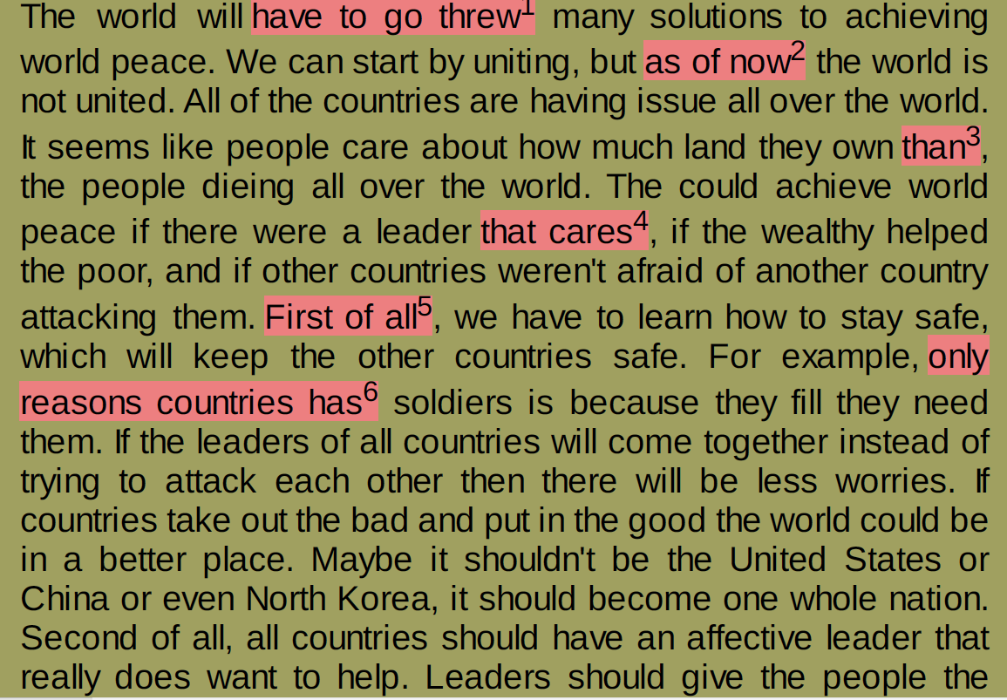
QG Example
1: Check whether you meant to use "threw" here. A verb such as "threw" is usually in present-participle (-ing) form following a verb such as "have to go”
2: The phrase can be rewritten more clearly. " as of now"
3: Consider using "then" here. "Then" refers to a point in time. "Than" refers to a comparison.
4: Check whether you intended to use "cares" here. A singular determiner such as "that" is not usually used to modify a plural noun such as "cares” " that cares”
5: The phrase can be rewritten more clearly. " First of all"
6: The verb "has" may not agree with the subject "only reasons countries”.

Slide 9
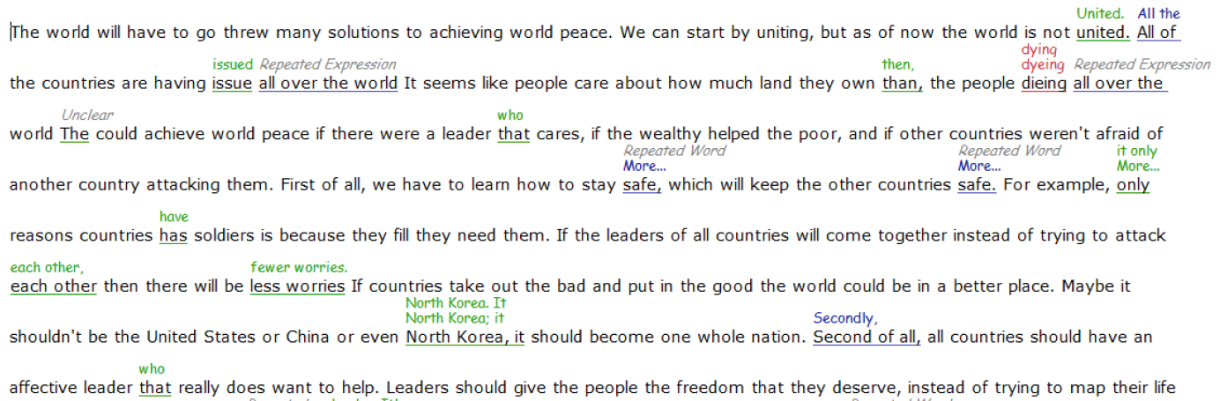
FB Example

Slide 10
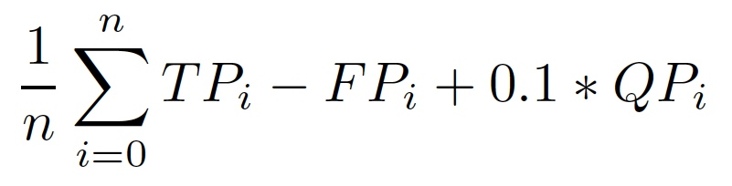
Situation Encountered
Publisher’s system in operation in schools.
  System permits up to 6 iterations.
  Feedback covers both content & form.
  Seems accurate in overall scoring.
IN HOUSE Performance Metric
IN-HOUSE: QG
VENDOR: FB
Notes:
10

Slide 11
Analysis Method
Publisher’s Performance Metric:
System finds errors; categorize errors {TP, FP, QP}.
Calculate a precision-like value per system.
Ground Truth Metric:
Experts find errors; then compare to systems’ work.
Calculate precision and recall (or FP & FN rates)

Slide 12
Human-coded Reference Annotation Conventions
REF (hand-coding of core errors in 24 sample essays):
    Analysis base 440 Sentences
    When in doubt, accept as correct.
REF Sample
with human
annotations
human
editors
Student text
sample:
24 essays;
8800 words
Text Sample
analyzed by
FB
FB
QG
Text Sample
analyzed by
QG

Slide 13
Analysis at three levels
Sentence Errors
  Coherence, style, and structure of a sentence; independent of specific local errors.
Word/Phrase Errors
  Localizable errors, labeled.
Label Errors
  Error labeling (Tag-type confusion matrix).

Slide 14
Materials
Total: 24 essays, 440 sentences, 8840 words;
Random sample from students aged 12-15;
Average essay: 18 sentences, 370 words;
Human Annotation
2 readers + 1 reader (disagreement resolution)
Error types (SGLUC):
S: Sentence
G: Grammar
L: Spelling
U: Usage
C: Convention
Notes:
14

Slide 15
Sample
… For example, only reasons countries has soldiers is because they fill they need them. …
S: Bad sentence, too long, run-on, fragment, non-parallel, incoherent.
G: Grammar, agreement, parallel verb form, …
L: Spelling, includes capitalization, & special characters within a word.
U: Usage, includes wrong lexical item, or pronoun, or missing article, …
C: Convention, includes punctuation, spaces, non-standard abbreviation, …
… For example, <<U>> only <<G>> reasons countries <<G>> has soldiers <<G>> is because they <<L>> fill they need them. …
Notes:
15

Slide 16
Exercise (optional)
Children are growing up faster than there parents or guardians would like and I think that it is both good and bad for children to be looking at clothing magazines, but it is more of the parents decision than the child's or even my own for that matter.
S: Bad sentence
G: Grammar
L: Spelling
U: Usage
C: Convention
Notes:
16

Slide 17
FB ~ REF & QG ~ REF
(sentence level)
  REF: 54 sentence errors in 440 sentences
FB:
  TruePos = 15; FalsePos = 16;
  FalseNeg = 39; TrueNeg = 370;
  Precision=0.48 Recall=0.28 F1=0.35
QG:
  TruePos = 12; FalsePos = 18;
  FalseNeg = 42; TrueNeg = 368;
  Precision=0.40 Recall=0.22 F1=0.29
Notes:
17

Slide 18
FB ~ REF & QG ~ REF
(word level)
  REF: 622 errors in 8840 words
FB:
  TruePos = 129; FalsePos = 197;
  FalseNeg = 493; TrueNeg = 8021;
  Precision=0.40 Recall=0.21 F1=0.27
QG:
  TruePos = 107; FalsePos = 131;
  FalseNeg = 514; TrueNeg = 8061;
  Precision=0.45 Recall=0.17 F1=0.25
Notes:
18

Slide 19
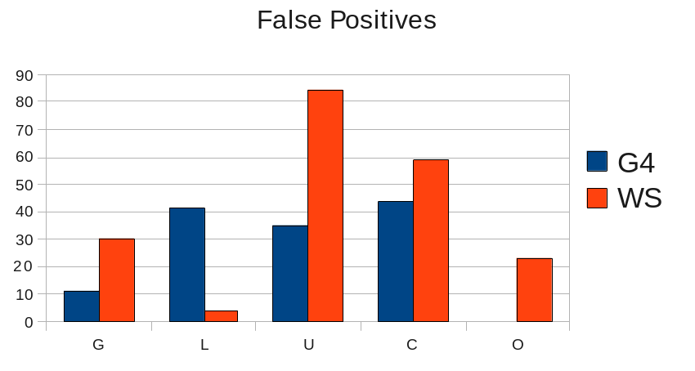
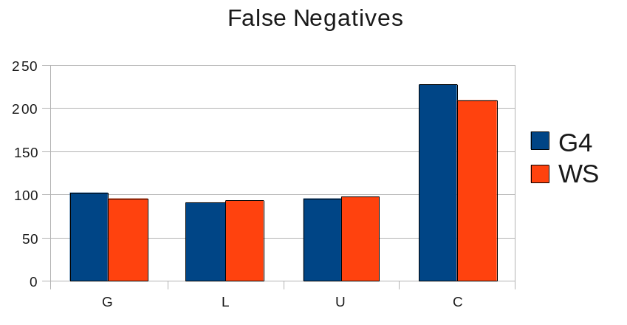
Word Errors by Type
(FB ~ QG)
G-, U-, C-type and Other-type errors lower FB precision
(Red bars in
upper chart.)
FALSE Positives
QG
FB
G L U C O
FALSE Negatives
QG
FB
G L U C

Slide 20
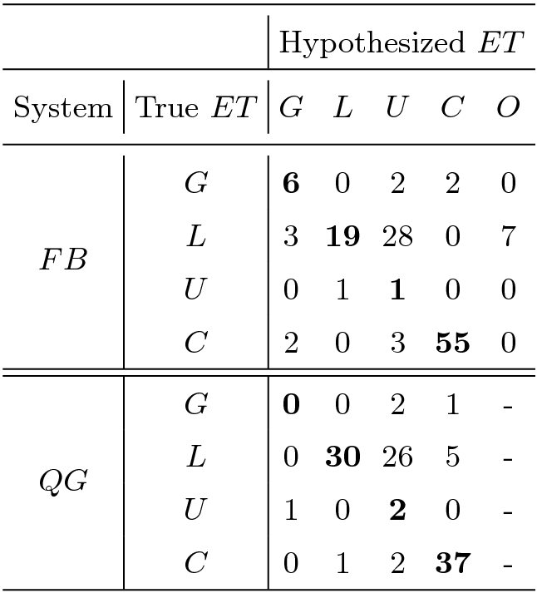
Confusion Matrix
(Real Word Errors Detected)
Error Types (ET):
G – Grammar
L – speLling
U – Usage
C – Convention
O – Other
FB marks “other” error types
Spelling feedback task is still more challenging
Notes:
20

Slide 21
Effect Size
Expected difference in marks per Essay
Average Sentence = 17 words
Average Essay = 12 sentences
Auto-marking rate = 1 mark per 40 words
Average Essay = 272 words, 6.5 marked errors
Example: (Assume 7 errors/essay)
  3 good and 4 bad (prec. = 0.40)
  2 good and 5 bad (prec. = 0.35)
  (actually 2.6 ~ 2.3, one rounds up, the other down)
One more accurate feedback mark per two essays.

Slide 22
Results Summary
For publisher’s purpose, results were clear
  QG > FB in precision (only finding real errors)
  FB >> QG in recall (leaving fewer errors missed)
  Effect size is small. ~ One difference per two essays.
Notes:
  Both systems have F1 at about 0.3 – high error rate.
  Feedback is difficult.
  Correction choice is a separate, difficult problem.
Notes:
22

Slide 23
Judgments
Neither engine (FB or QG) is very accurate
  (spotting all & only real grammatical errors)
Task is hard; systems lack
      adequate training data and unified statistical model
      established performance metric
    content context and model of author intention
    technique for selecting among correction options

Slide 24
Related COLING 2012 Paper
Problems in Evaluating Grammatical Error Detection Systems
CHODOROW, DICKINSON, ISRAEL, & TETREAULT
Proceedings of COLING 2012: Technical Papers, pp 611–628
The three-way contingency between a writer’s sentence, the annotator’s correction, and the system’s output makes evaluation more complex than in some other NLP tasks.
The low frequency of errors… leads us to recommend the reporting of raw measurements (true positives, false negatives, false positives, true negatives).
Particularly vexing: specifying the size or scope of an error, properly treating errors as graded rather than discrete phenomena, and counting non-errors.

Slide 25
Teachers: what do they do?
What is teacher feedback like?
  Typically teachers re-write, but only selectively.
Why?
  Limited time.
  Instructional focus varies.
  Severity of errors varies.
  Guidance by positive example.
Notes:
25

Slide 26
Teacher-Graded Essay
Edit these TWO essays as if you are teaching a middle school English class. Make corrections/suggestions exactly as you would if you were going to hand this back to one of your students.
Write about your favorite president.
The one president that I greatly admire the most would be president Abraham Lincoln. The reason why I think that Abraham Lincoln was one of the greatest presidents of all time was because he led us through the issue of slavery. Which was later abolished by the Union President Abraham Lincoln served as the 16th president of the united states from March 1861 until his assassination in April of 1865. He successfully led his country through a huge debacle, the American Civil War, and led the Union into abolishing slavery. This was huge. But before his first election as the first republican, he was a country lawyer, and Illinois state legislator, a member of the united states house of representatives, and twice an unsuccessful candidate for the election to the U.S senate. He handled a lot of dismay before he became the 16th president of the United States. Lincoln later won the Republican party nomination in 1860 and was later elected president that year. He introduced measures that resulted in the abolition of slavery, issuing his …

Slide 27
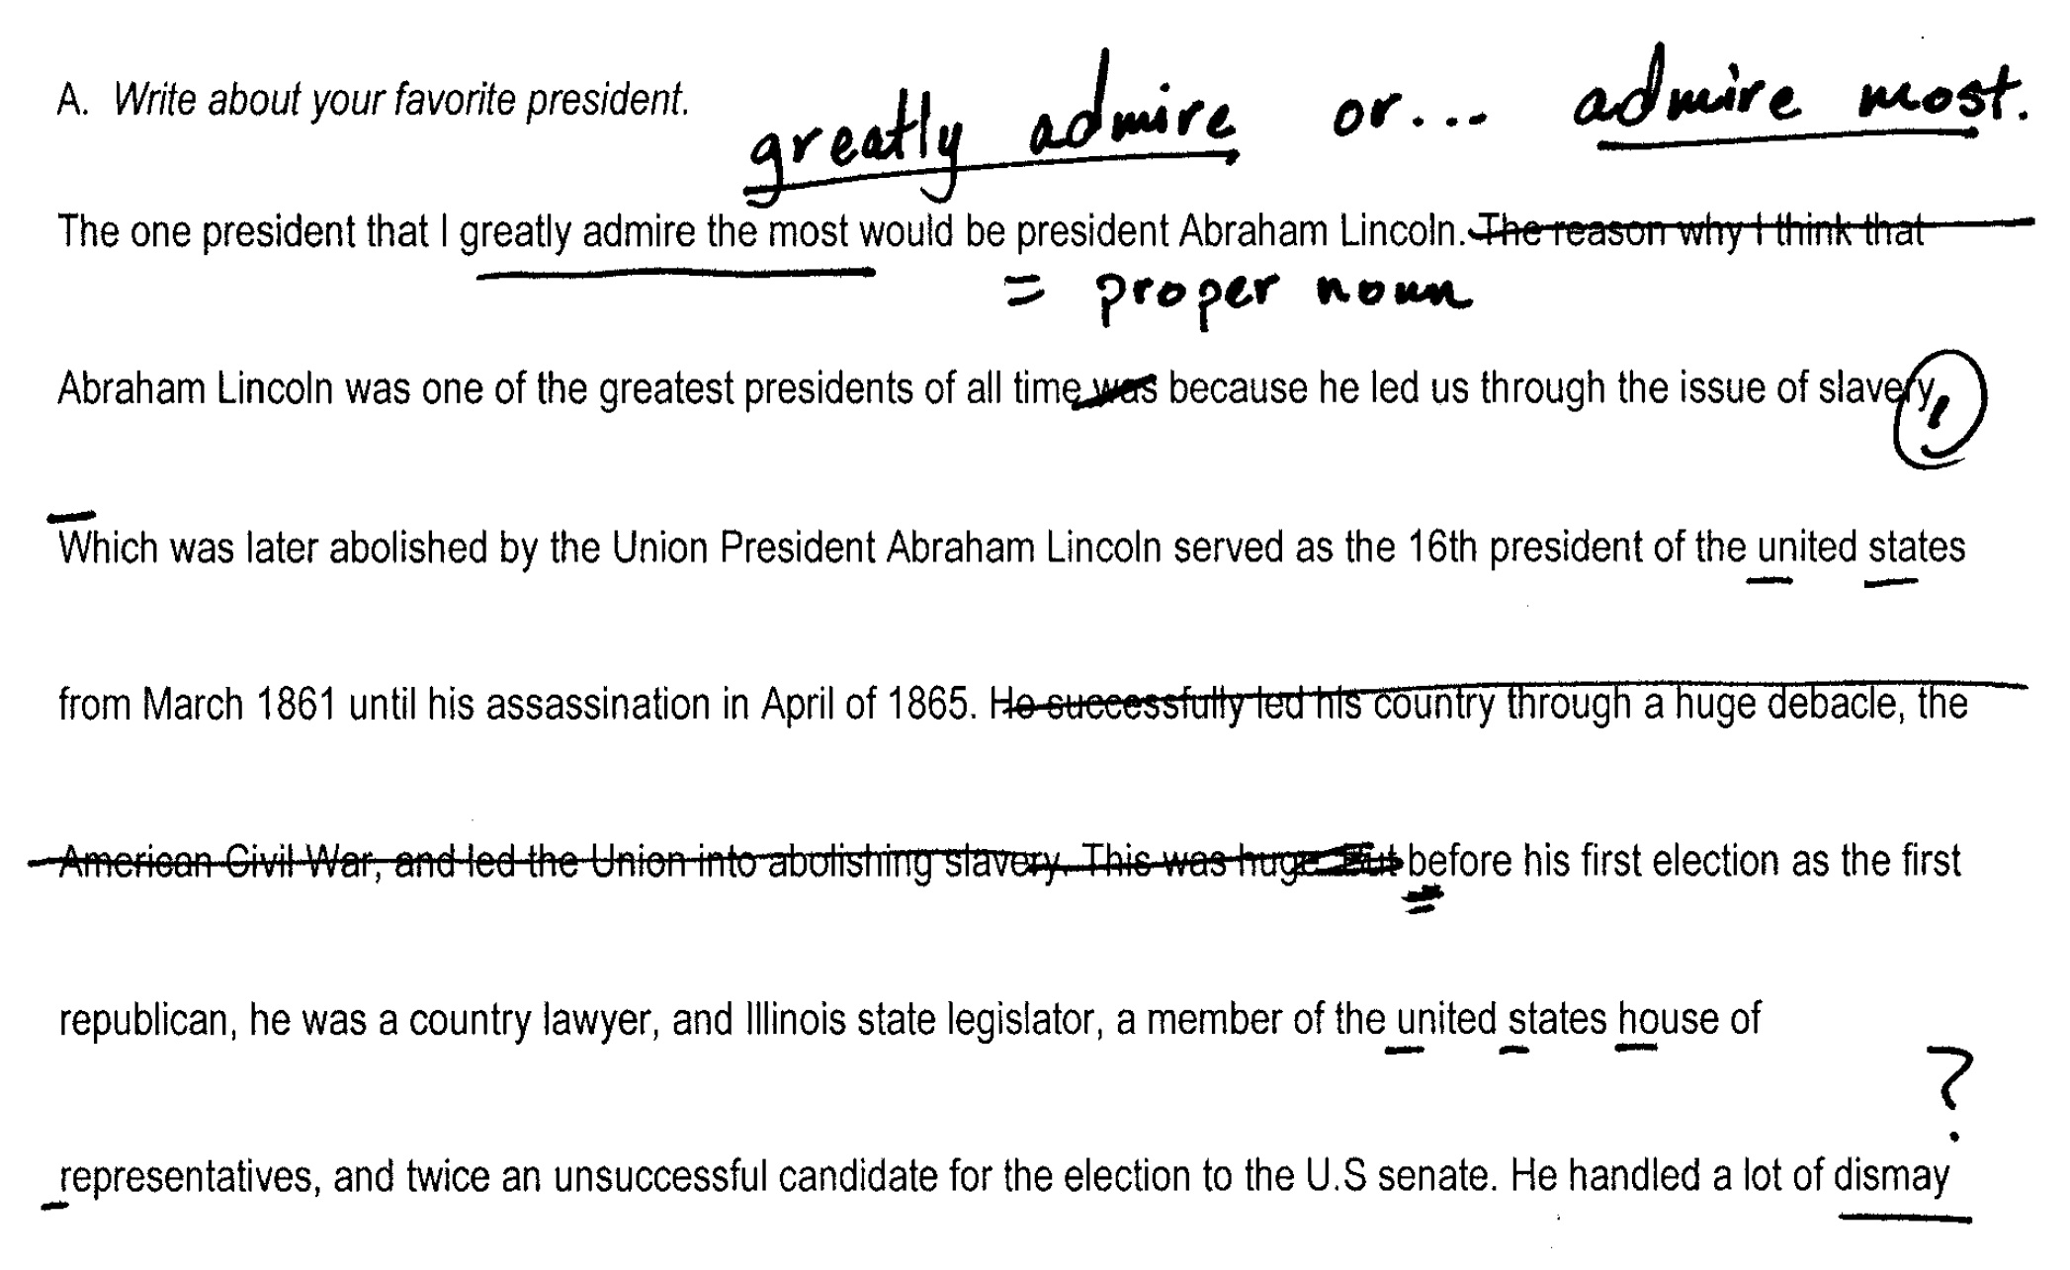
Correction Example

Slide 28
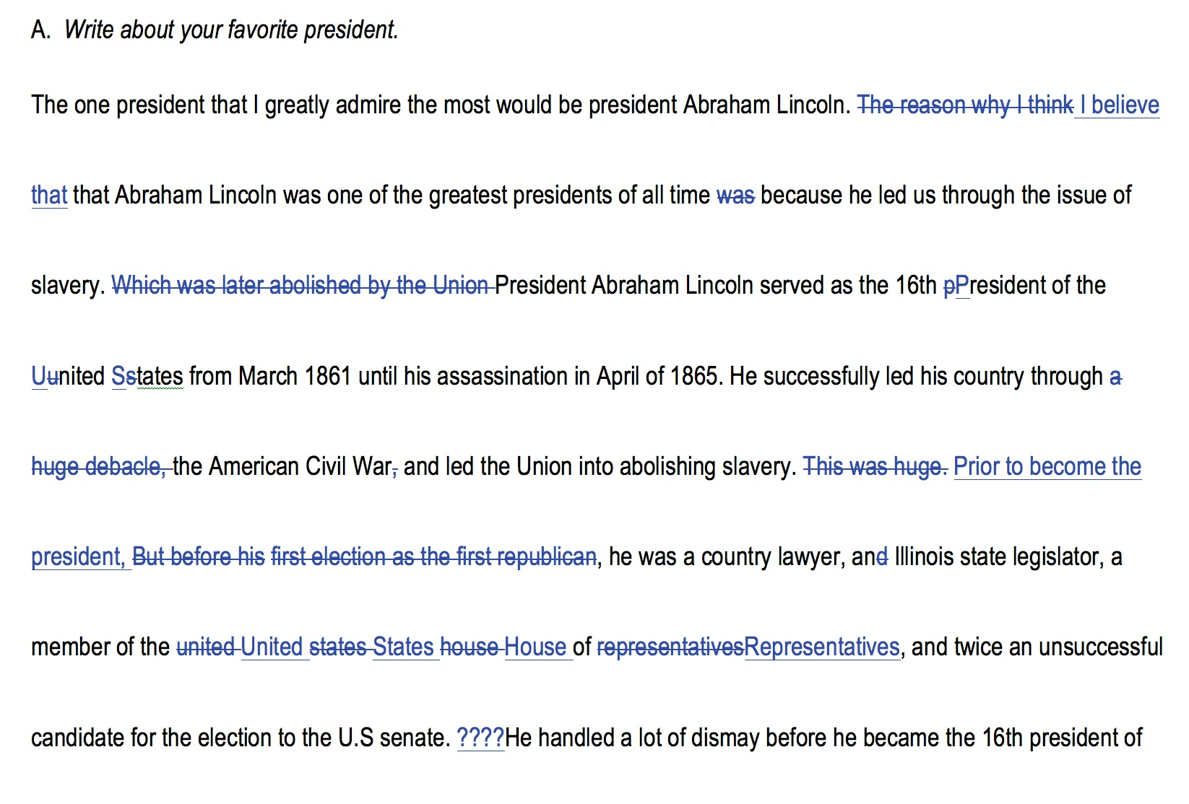
Correction Example 2

Slide 29
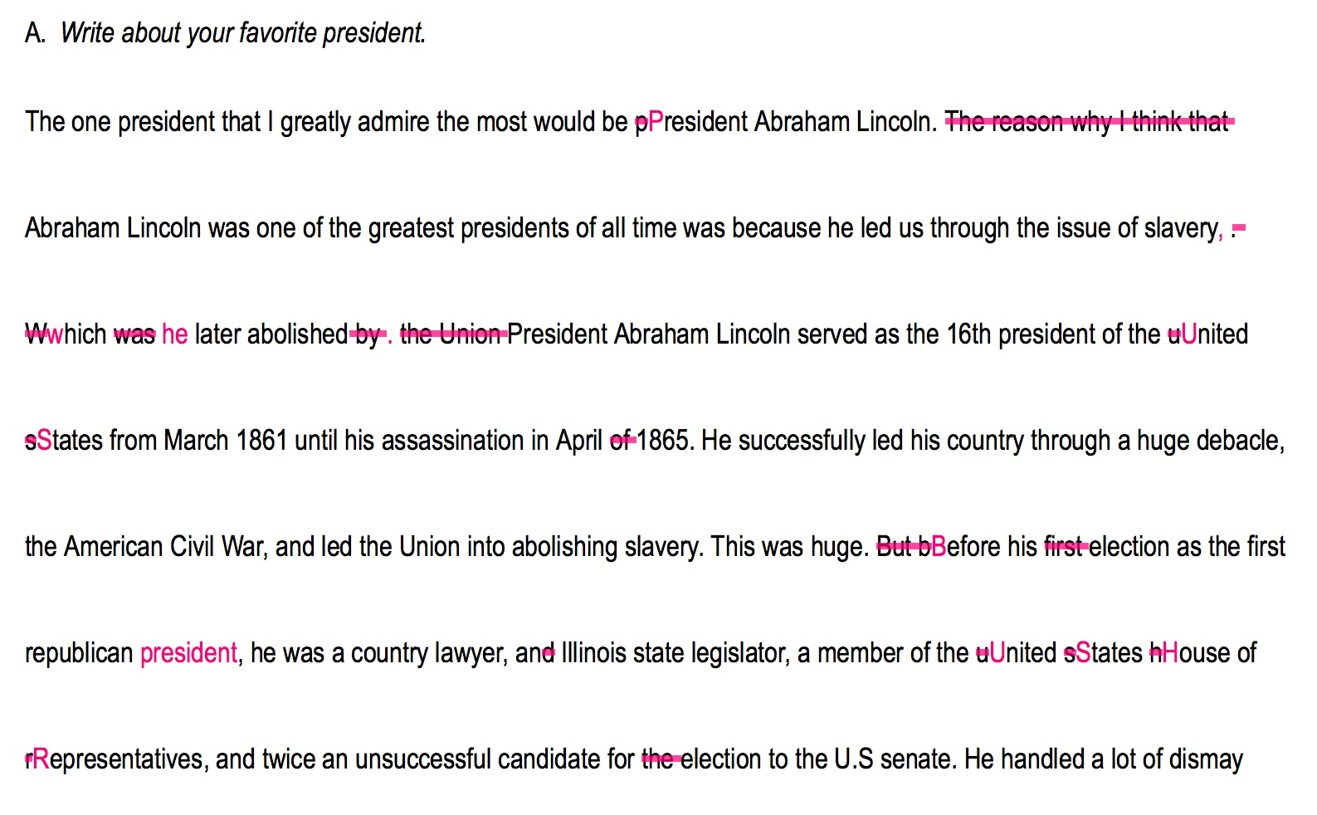
Correction Example 3

Slide 30
Teacher Observations
Re-write problematic spans
Give positive examples of appropriate text
Attention selectively focused
  (Variously) rhetoric, spelling, convention, style, usage
Mark more errors than machines
Feedback inconsistent between teachers
Feedback inconsistent from individual teachers
Notes:
30

Slide 31
Service Supports Development
Suggestion:
  set up a service for teachers that collects essays and offers a constrained set of tools for correcting student draft texts.
Features:
  convenient interface for teachers and students,
  feedback presented in a helpful form to the students,
  offers small palette of error types, and
  aggregates statistics on error patterns (for teachers).
Product:
  data set with uniform error marks; aligned re-writes to support development of automated essay feedback.
Notes:
31

Slide 32
Tentative Conclusions
Proprietary technology limits technical development
    ad hoc methods (expert systems, like NLP in 1988)
      opening for newer technology, e.g. translation
    no shared/accepted error labeling convention
      start with minimal set; refine over time
    limited data resources
  field a system that teachers can use and find useful;
  build a database from it.

Slide 33
Reflections on Essay Feedback
Developers have accepted precision-like evaluation.
Teachers react to both false positive & false negative.
Suggest 15 re-writes; add 150 bits: sum = 230 bits
Prioritize by severity; add 40 bits: sum = 270 bits
    Information product, per essay per iteration:
(full feedback) 270 bits >> (scoring) 6 bits

Slide 34
Thank you.
jared.bernstein at stanford.edu

